Slide 1
Toxic Comment Classification
Presentation by:
Charles Biddle Porter, Duc Hoang, Harshit Gole, Kirti Vatsh, Manan Dhanteja

Slide 2
Table of contents
01
02
03
04
05
06
Problem, Importance, & Impact
Dataset
Exploratory Data analysis
Other Models
Model & Solution
Conclusion & Next Steps

Slide 3
01
Problem, Importance, & Impact

Slide 4
Problem - Toxicity
Issue
Importance
Impact
Online platforms plagued with Toxic remarks
Degrading the quality of conversation
Illusion of anonymity
Mass adoption of social media
Protect individuals from online harassment
Rising hate speech
Affects mental health
Negate the harmful effects
Make online discourse a safe space

Slide 5
Dataset
02

Slide 6
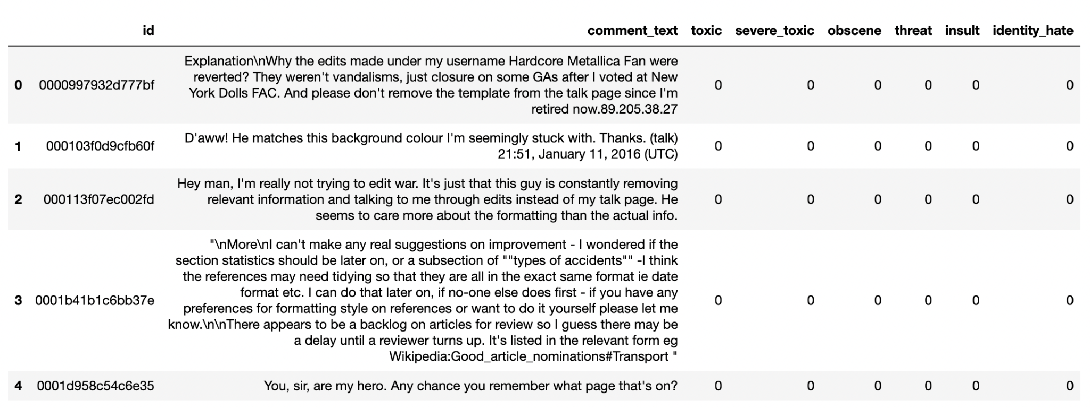
Dataset
Source: https://www.kaggle.com/competitions/jigsaw-toxic-comment-classification-challenge/data
Notes:
Today, I’ll be introducing the dataset we are using for our toxic comment detection project. This dataset is crucial as it forms the backbone of our model training process.
The training dataset contains a unique identifier, input comment_text and 6 different categories of toxicity. Each comment in the dataset has been labeled with binary values, where '0' represents the absence and '1' represents the presence of the respective category of toxicity.

Slide 7
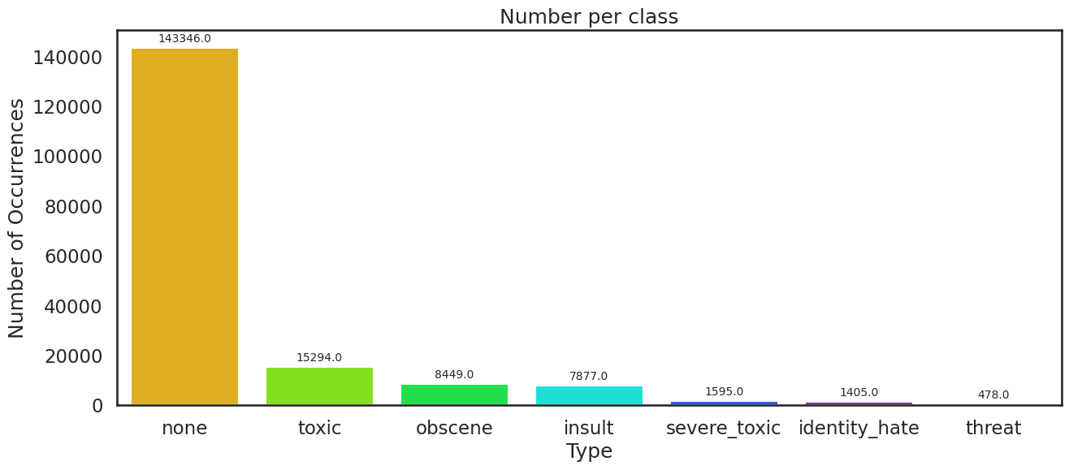
Understanding Data
Columns: ID, comment_text, Six labels (toxic, severe_toxic, obscene, threat, insult, identity_hate)
Rows: 159 k
Labels: Not-Mutually exclusive
Notes:
This graphs shows the number of clean comment and toxic comment. The classification of toxic comments is not mutually exclusive which means that one comment can be classified as one or more type of toxicity. For example, bla bla

Slide 8
Exploratory Data Analysis
03
Notes:
The foundation of what will later be extended by data preprocessing strategies to optimize our model performance is the EDA. It involved investigating the correlations between various categorical labels, analyzing the distribution of these categories, and understanding the dominance of one category over another.

Slide 9
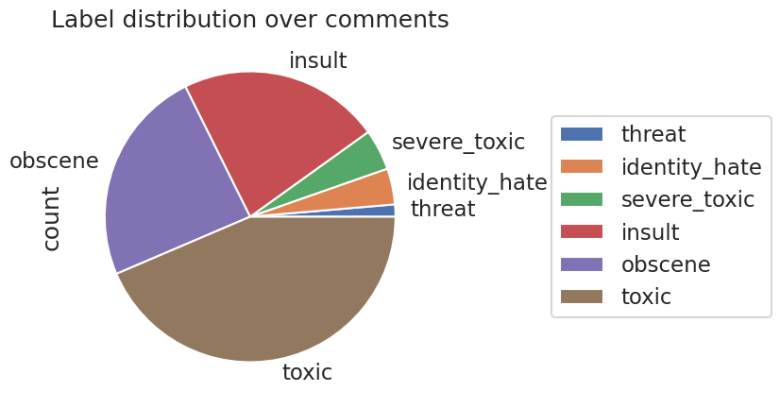
Labels
Notes:
Firstly we’ll cover the distribution visualization via pie plot of the major toxic labels classified in terms of the high to low counts: they are toxic, obscene and insult. Explore each topic..

Slide 10
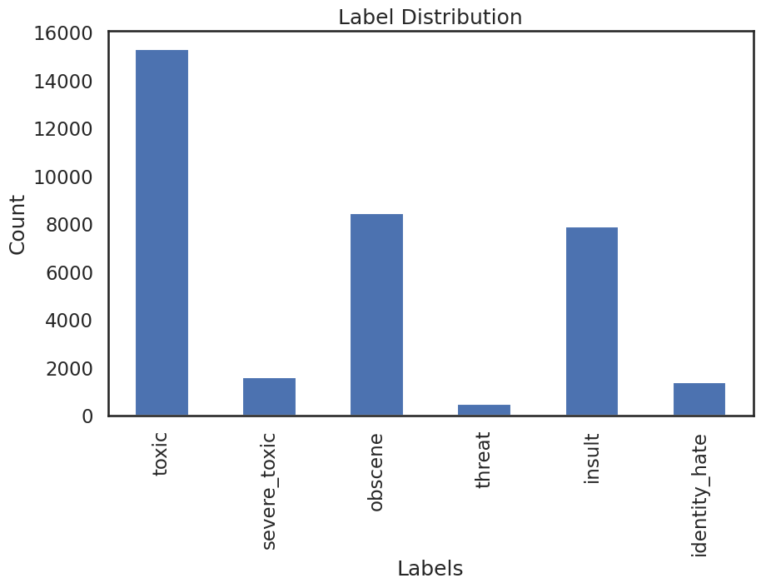
Label Distribution
Notes:
In bar graph demonstrates frequency visualization. Next, we’ll explore the underlying patterns between the labels via corr heatmap

Slide 11
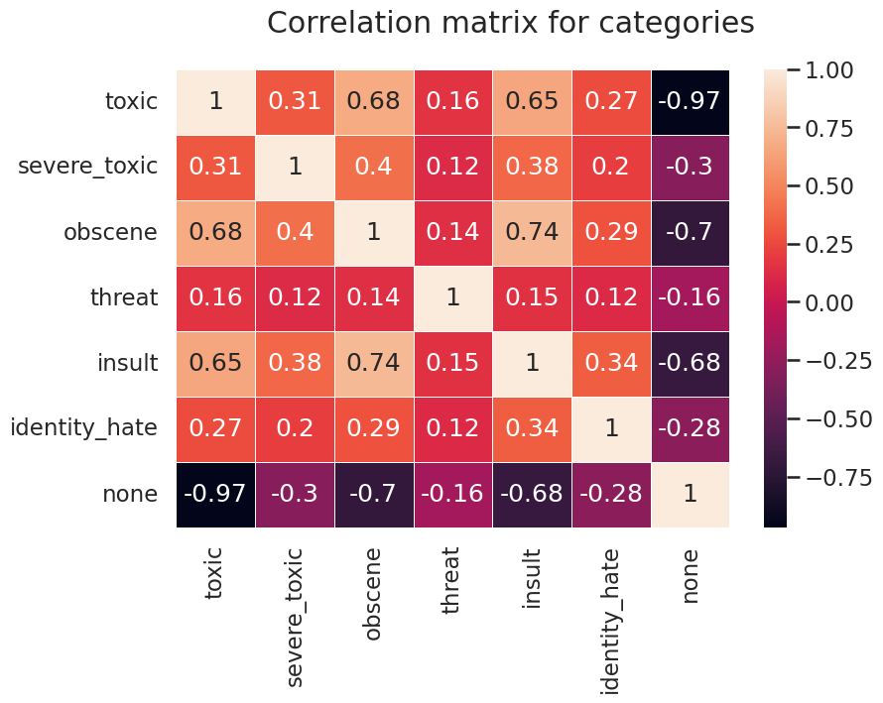
Correlation Matrix
Notes:
(1) ’toxic’ exhibits strong correlations with ’obscene’ and ’insult’ at coefficients of 0.68 and 0.65, respectively.
(2) correlation between ’toxic’ and ’severe_toxic’ is notably lower at 0.31.
(3) ’insult’ and ’obscene’ display a substantial correlation factor of 0.74.
(4) semantics show some kind of graduation between them ’toxic’ <-> ’severe _toxic’, ’insult’, ’obscene’ and ’insult’ <-> ’obscene’
Next we cover Venn Diagrams…

Slide 12
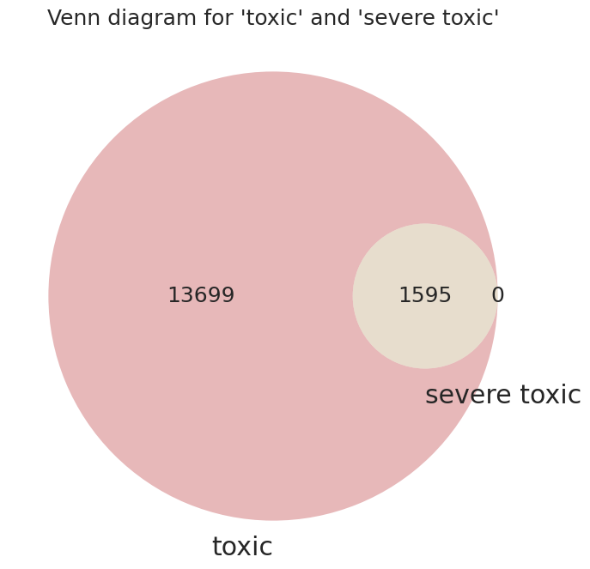
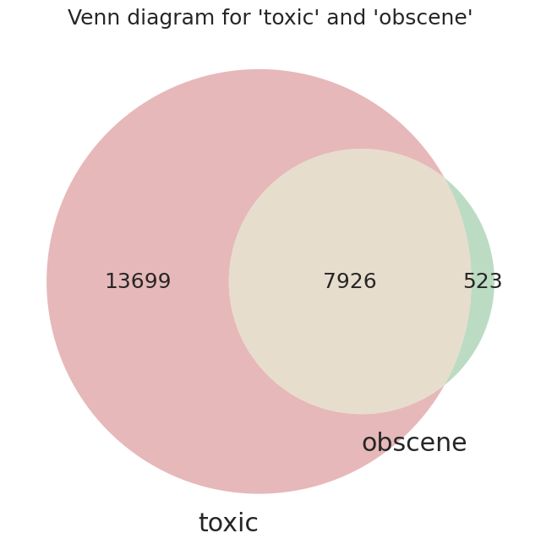
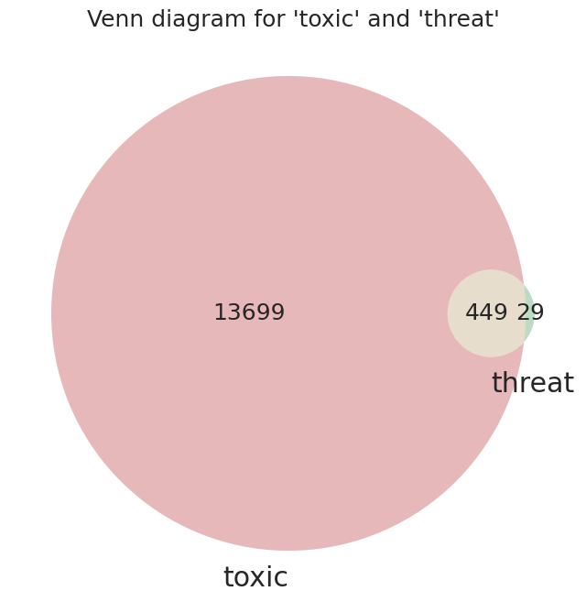
Venn Diagrams
Notes:
Looking at the Venn diagrams confirms that the data is mutually non-exclusive, we can say: The ’severe _toxic’ category is entirely subsumed within the ’toxic’ whereas obscene and threat show

Slide 13
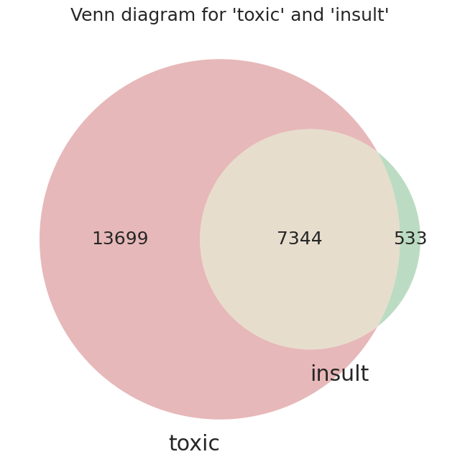
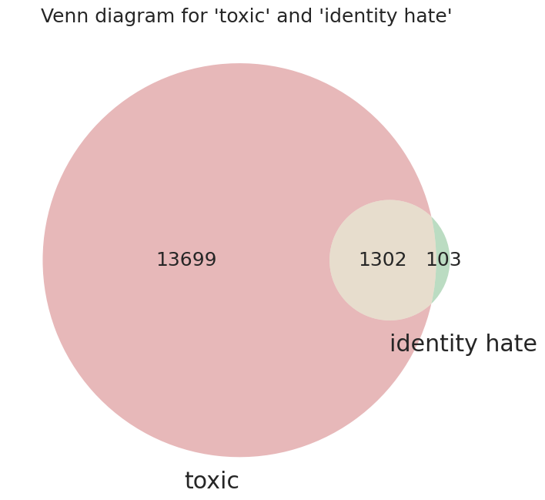
Venn Diagrams
Notes:
More on toxic and insult, toxic and id hate… next we’ll cover another corr heatmap that will help with feature refinement

Slide 14
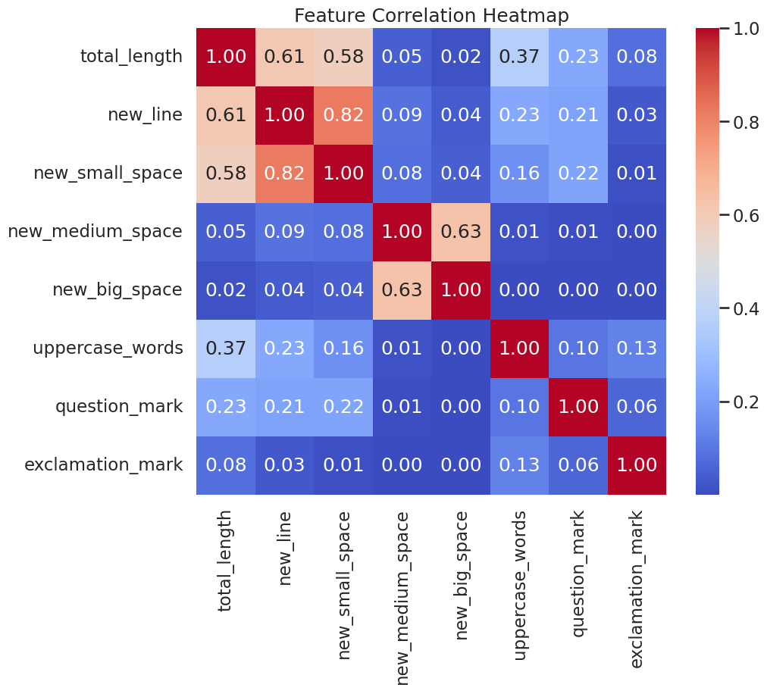
Feature Corr Matrix
Notes:
the structural aspects (1) Total Length: level of the writer’s involvement (2) Total Number of Carriage Returns: presence of carriage returns → formatting pattern (role of emotion/motivation). (1) no strong correlations. (2) ’uppercase_words’ (which could be assimilated to ’yelling’) (3) ’uppercase_words’ correlated with ’exclamation_mark’ up to 0.13 ~add many ’!’ indicate ’yelling’ ;)

Slide 15
Trigger Warning
Following slide only represents data and is not meant to offend anyone!!
Notes:
Permission to display the words we were screening for… we used the clean_text function to convert the text to lowercase, remove punctuation, eliminate stopwords. These are word clouds for the toxic and severe toxic labels. Having established the groundwork for our subsequent efforts in building a robust classification model that Kirti will cover next.

Slide 16
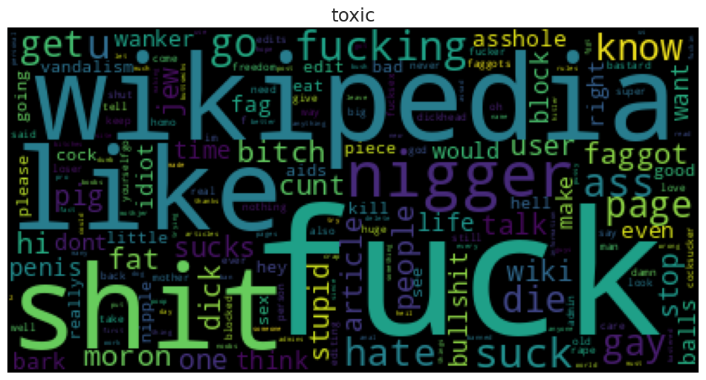
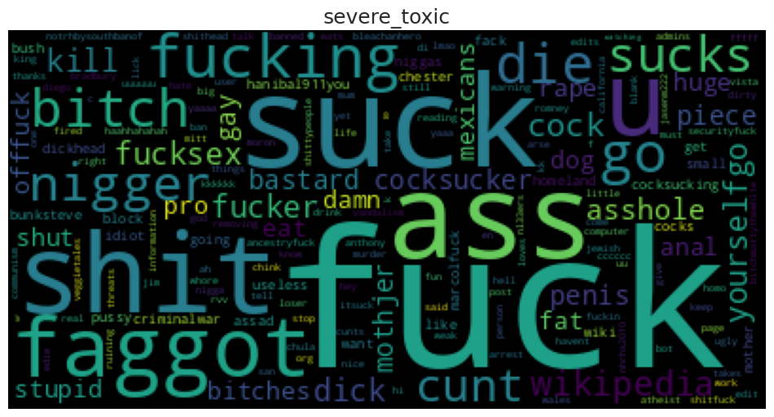
Word Cloud

Slide 17
Other Models
04

Slide 18
TF - IDF ( Initial Proposal)
A statistical measure that evaluates how relevant a word is to a document in a collection of documents.
TF - IDF = (Term Frequency) * (Inverse Document Frequency)
Distinguish word significance and information retrieval
Applicable in document classification, search engine scoring, content summarization and many more.

Slide 19
What Went Wrong?
Lack of Semantic Understanding
Neglecting word order and context
High dimensionality issues with large vocabulary that can be computational extensive and less effective
Inability to handle new words
Poor performance on imbalanced models

Slide 20

Other Solutions
SVM with TF - IDF or Bag of Words
Random Forest by classifying comments based on features derived from text
XLNet that operates on permutation based modeling
KNN with TF-IDF weighted word frequencies to identify semantic similarity between comments
Notes:
For XLNet, extension of the Transformer model that incorporates the permutation-based language modeling objective, excels in tasks requiring deep contextual understanding.

Slide 21
Model and Results
05

Slide 22
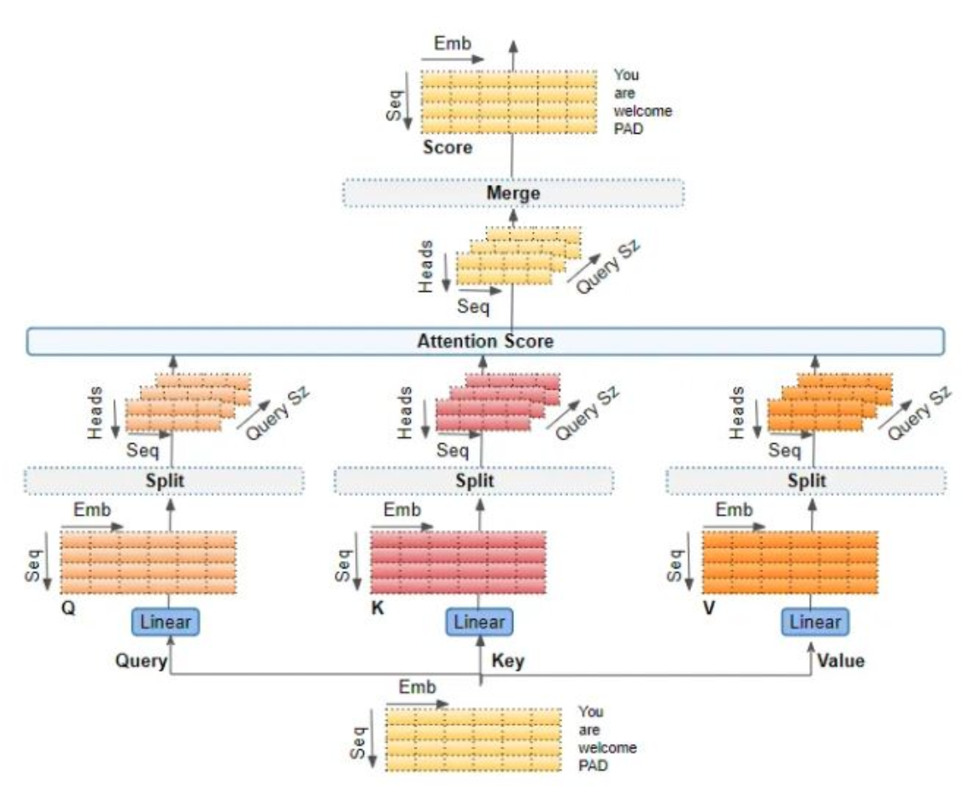
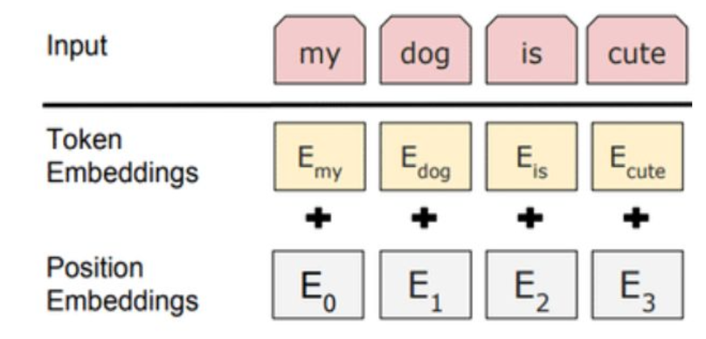
Model
Transformers
Handles long-range contextual interdependency
GloVe embeddings 6B - 300 dimension
Trained on a corpus of 6 Billion words
Token and Positional Embedding
Multi-Head Attention
Enhanced Representation Learning
Improved Generalization
Parallelization

Slide 23
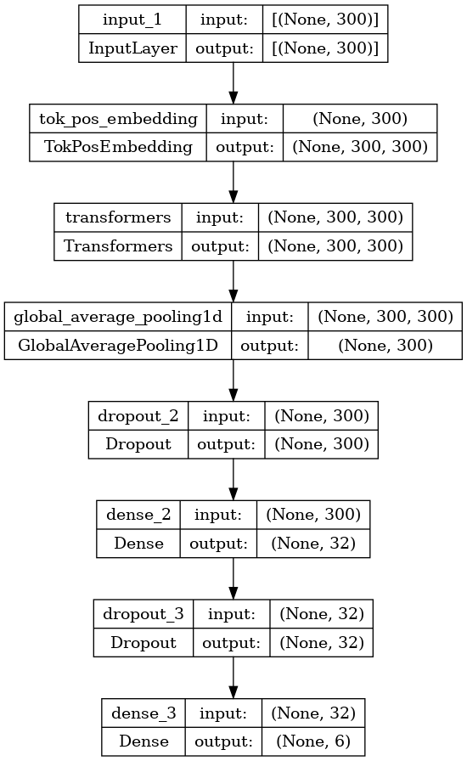
Model Architecture

Slide 24
Results
With a threshold of 0.7, on the final output values of the model on evaluation set, we get these results by training on a single epoch.
Accuracy: 0.965
 | Precision | Recall | F1 Score
Toxic | 0.925975 | 0.920963 | 0.896401
Severe Toxic | 0.979749 | 0.989822 | 0.984760
Obscene | 0.894025 | 0.945529 | 0.919056
Threat | 0.993243 | 0.996615 | 0.994926
Insult | 0.899390 | 0.948361 | 0.923227
Identity hate | 0.981139 | 0.990524 | 0.985809

Slide 25
Conclusion
& Next Steps
06

Slide 26
Conclusion
Set out to clean up online conversations
Utilised class concepts of Transformers and Transfer Learning (GloVe)
Achieved through implementation of our model
Lessons learned:
TF-IDF is not an ideal technique for semantic classification
More widespread literature review, explore different methods
Longformer

Slide 27

Next Steps
Run model on a new data set
More widespread development of these models
Kill toxic comments

Slide 28
Thanks for listening.

